Slide 1

PROJECT HCHQ
By Euston Tan, Justin Wen, Boston Tan,Zhou Yan

Slide 2
CONTENTS
01
06
INTRODUCTION
PRODUCT
02
07
LITERATURE REVIEW
TESTING
03
08
METHODOLOGY
CONCLUSION
04
09
OVERVIEW
GITHUB
05
10
IMPLEMENTATIONS AND RECOMENDATIONS
REFERENCES

Slide 3

Who we are
INTRODUCTION

Slide 4

ROLES
Euston Tan
Boston Tan
Coder/Ideator
Coder/Designer
Justin Wen
Zhou Yan
Music designer/ Coder
Product Tester
Notes:
These are our roles . Euston is a coder and ideator and Boston is also a coder and visual designer.Euston works with Boston to create the map. Justin also codes but is in charge of designing in game music and then coding it into the main game. Zhou Yan is the project tester and ensures that there are no bugs in the project by repetitively testing the game.All bugs are then resolved by Euston or Boston,who are in charge of the game’s development.

Slide 5
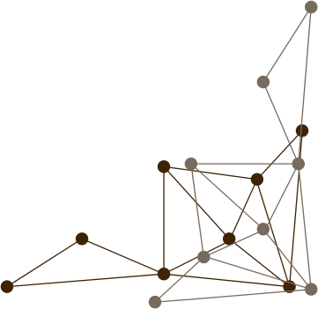
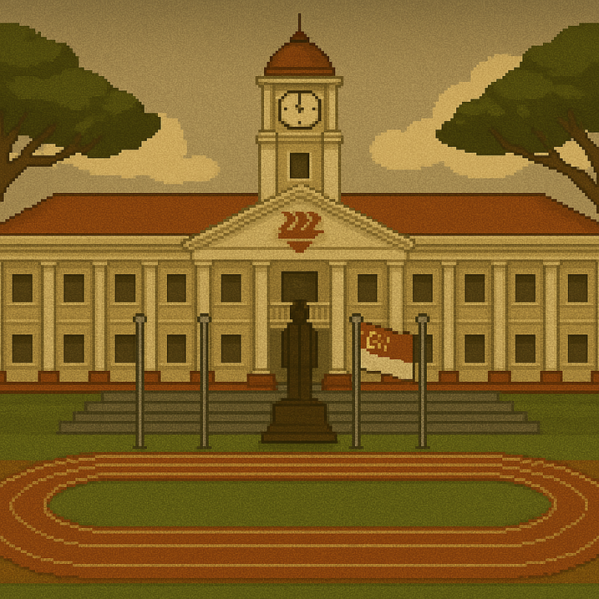
What is HCHQ?
An interactive game regarding history that aims to be a fun and interactive experience for students.
Who is HCHQ for ?
HCHQ is for people of all ages who wish to learn more about Hwa Chong’s rich culture since 1919.
Our Objective
We wish to make learning more fun and no longer just for results .
ABOUT HCHQ
Notes:
So what is HCHQ? HCHQ is an interactive game regarding history that aims to be a fun and interactive experience for students. Its goal is to bring the fun back to learning. We specifically target History as it was one of the more wordy lessons. We decided to make this game based on HCI's history as HCI has a rich history .This allows students to actively participate in their own learning as well as take control over their pace of learning the history of the school.

Slide 6

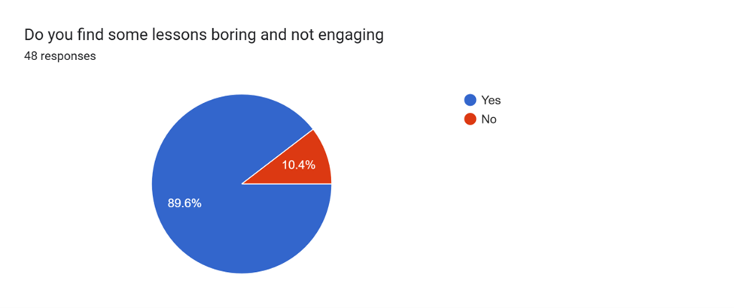
SURVEYS
Students find lessons not engaging

Slide 7
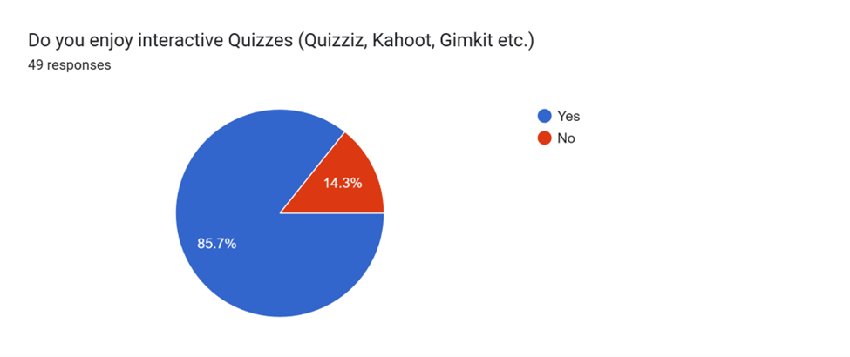
SURVEYS
Students enjoy interactive lessons

Slide 8
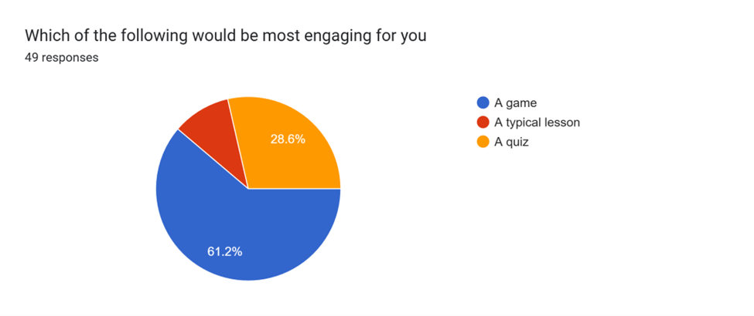
SURVEYS
Students find games most engaging.

Slide 9
Our research
LITERATURE REVIEW

Slide 10
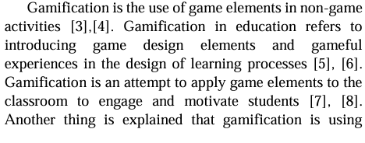
Introduction of game elements into learning process motivates students

Slide 11
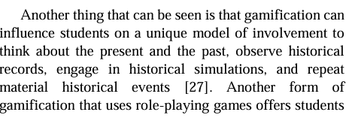
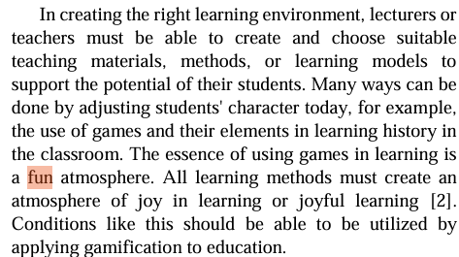
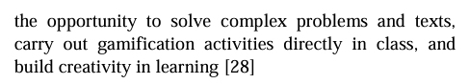
Gamification can allow students to engage in historical simulations in a fun manner.

Slide 12
Our Method
METHODOLOGY

Slide 13

What platform did we use
We used Game Maker Studios and coded in Game Maker Language (GML).
Why a game
In our survey, students find games and quizzes more interactive than normal lessons thus we decided to make a game.
Why a Role Player Game
We made our game a Role Player Game to enable students to learn at their own pace.
METHODOLOGY

Slide 14
More info on our game
OVERVIEW

Slide 15
OVERVIEW
History Based
Interactive Learning
For All
We design engaging history-based game content, to make learning Hwa Chong’s heritage fun and memorable.
Our Game enables not just students but the General public to know more about our school
We make learning fun and exciting
01
02
03

Slide 16
Our purpose
IMPLEMENTATION

Slide 17
OUR GAME
For Students
For Everyone
Our game is the perfect tool to assist students in learning about school history
Our Game is also meant to be a resourceful site for members of the public so that they can learn more about HCI’s history.
01
02

Slide 18
Our Game (Walkthrough)
PRODUCT

Slide 19
Others’ thoughts
TESTING

Slide 20
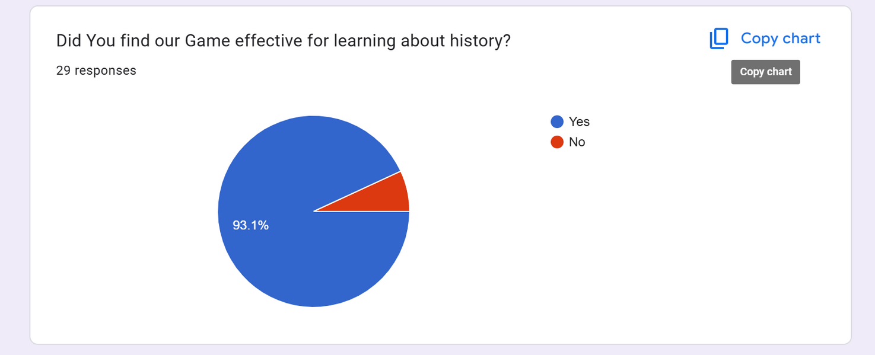
SURVEYS
Our testers found our game effective

Slide 21
Thoughts
CONCLUSION

Slide 22
CONCLUSION
Pros
To work on
Fun and interactive RPG game
We will eventually develop all areas in the school
01
02

Slide 23
How to find the game files?
GITHUB

Slide 24
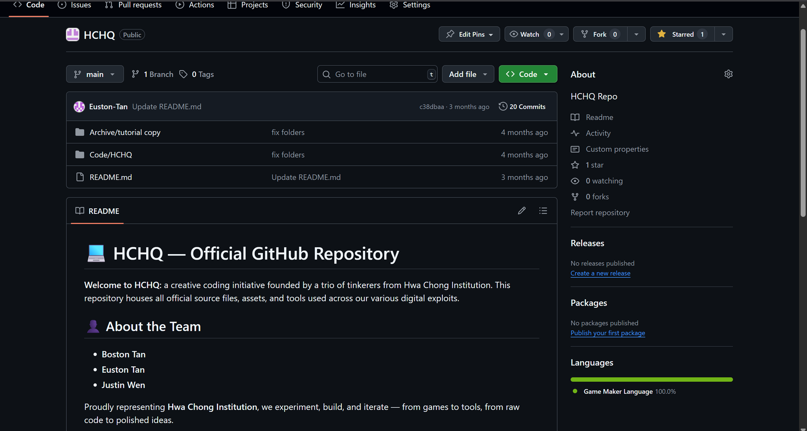
All of our code and game information can be found in our GitHub page. It is public and includes a folder in which there are resources we used to learn GML.
https://github.com/ProjectWork-Infocomm/HCHQ

Slide 25
Our sources
REFERENCES

Slide 26
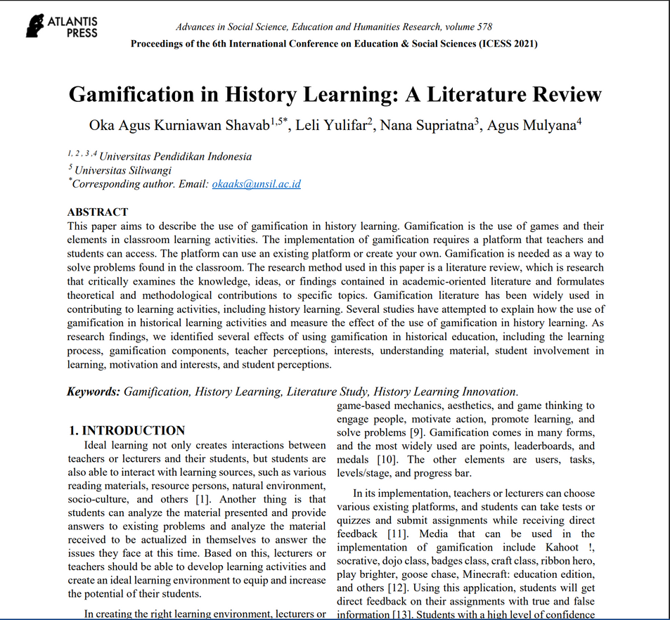
We referenced this research paper by Oka Agus Kurniawan Shavab, Leli Yulifar, Nana Supriatna, Agus Mulyana published by Atlantis Press. We used this for our literature review.

Slide 27

Ingoude Company
THANK YOU
FOR YOUR TIME AND ATTENTION
Presented by Euston Tan, Justin Wen, Boston Tan ,Zhou Yan

Slide 28
Questions
Q/A

Slide 29




OUR PRODUCT VS COMPETITON
Our Game allows students to go at their own pace instead of a timer in other games or punishment which requires paying or waiting.

Slide 30
WHAT ASPECTS OF HISTORY ARE SHOWN?
INSERT PICS
In our game, we included some historical figures important to our school like Mr Tan Kah Kee

Slide 31
WHY IS RPG BETTER
INSERT PICS
A RPG game allows students to move at their own pace. This is better compared to other games like Kahoot which have a timer as it would not give students unnecessary stress

Slide 32
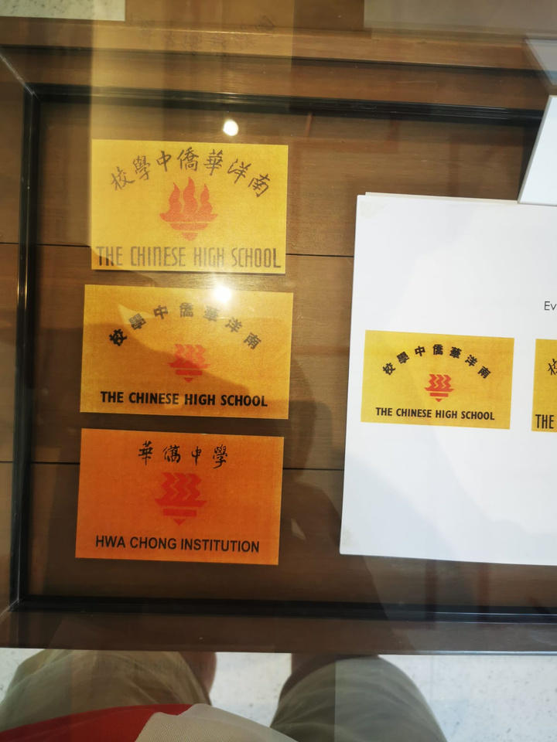
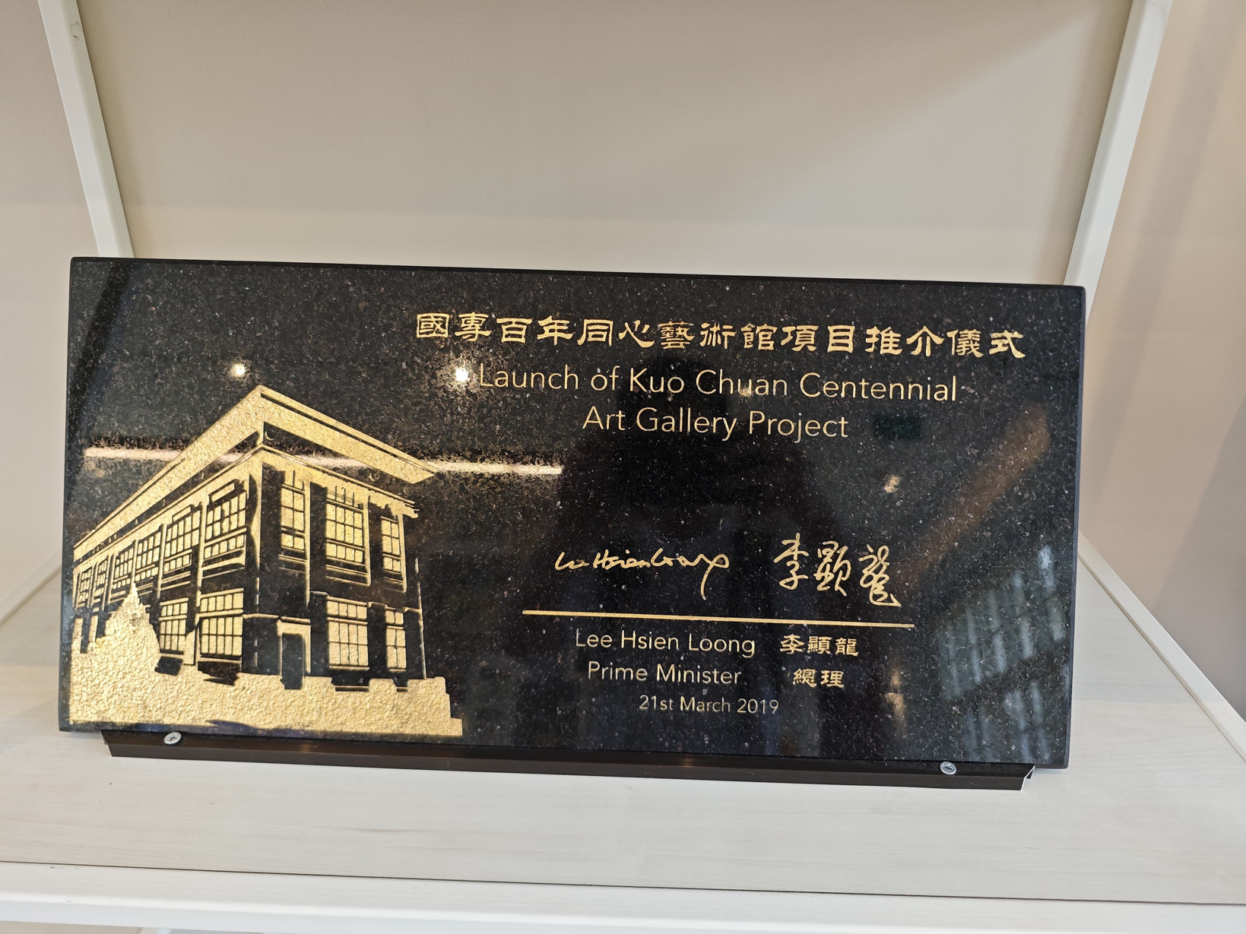
HOW WE ENSURE ACCURACY
We cross reference multiple sources of information including textbooks and went to the Kuo Chuan House to get more information.

Slide 33

WHY GMS
We chose GMS as the interface was simple and there was many RPG tutorials online. It also allowed us to make designs easily.

